Slide 3
In Compass survey chain or tape is used for linear measurements and compass is used for fixing direction.
In compass freely
suspended
magnetic needle bearing of line is
directs to north- south and the obtained by line of sight.

Slide 4
The principle of compass surveying is traversing;which involves a series of connected lines.
The magnetic bearings of the lines are measured by prismatic compass and the distances of the lines (i.e. AB,BC,CD,DE,EA) are measured by chain.
Such survey does not require the formation of a network
of triangles.

Slide 5
Traverse

Slide 6
Traversing
When large area are involved, compass surveying is used.
Traversing is that type of survey in which a number of connecting survey lines form the frame work and the
directions measured
and lengths of the survey lines are with the help of an angle measuring
instrument and a tape respectively.
When the lines form a circuit which ends at the starting
point, it is known as a closed traverse.
If the circuit ends elsewhere, it is said to be an open traverse.

Slide 7
EARTH MAGNETIC FIELD

Slide 8
EARTH MAGNETIC FIELD
Magnetic declination: The horizontal angle between the magnetic meridian and true meridian is known as magnetic declination.
Dip of the magnetic needle: If the needle is perfectly balanced before magnetisation, it does not remain in the balanced position after it is magnetised. This is due to the magnetic influence of the earth. The needle is found to be inclined towards the pole. This inclination of the needle with the horizontal is known as dip of the magnetic needle.

Slide 9
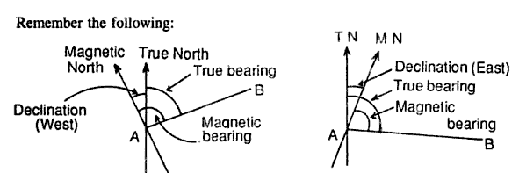
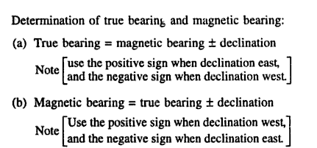

Slide 10
Prismatic compass
In this
needle
instrument, the remains in position (the
a fixed
position of the magnetic south to north line), while the two upper graduated circles, together with the line of sight, rotate about the vertical axis.

Slide 11
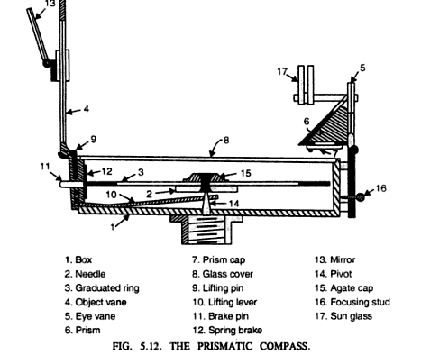
Prismatic compass

Slide 13
This surveyor's compass consists of a long, thin, pointed needle of magnetized steel with a small conical-shaped bearing of agate material at the centre.
The bearing works on a pointed pivot of hard steel carried at the centre of the low cylindrical metal box (140mm in diameter).
Attached to the opposite ends of this box are two sighting vanes with two slow motion screws and clamps which enable a definite line of sight to be defined or laid out.

Slide 14
The instrument can either be screwed on to a tripod or remain hand-held for the purpose of measuring magnetic bearings.
The metal box carries inside quadrants 0-90 degrees, with the N and S directions identified as zero points and the E and W directions are labelled as 90 degrees each.
The lower horizontal circle can read to 3 minutes directly
on the vernier.
A disc of glass, fitting on top of the metal case, protects the needle and graduated circles.

Slide 15
The compass centered over station A of the line AB and is
leveled.
Having turned vertically the prism and sighting vane, raise or lower the prism until the graduations on the rings are clear and look through the prism.
Turn the compass box until the ranging rod at the station B is bisected by hair when looked through the prism.
Turn the compass box above the prism and note the reading at which the hair line produced appears to cut the images of the graduated ring which gives the bearing of line AB.

Slide 16
.
There are commonly two bearing systems are used:
WHOLE CIRCLE BEARING:
In this system the bearing of a line measured with the magnetic north in clockwise direction. The value of bearing thus varies from 0º to 360º.
QUADRANTAL SYSTEM:
In this system the bearing of a line is measured eastward or
westward directions
from north or south whichever is near. The can be either clock wise or anti clockwise
depending upon the position of the line.

Slide 17
Every line has two bearings one observed at each end of the line.
The bearing of the line in the direction of progress of the survey is called Fore Bearing (FB), while the bearing in the opposite direction is called Back Bearing (BB).
Therefore BB of a line differs from FB by exactly
180º.

Slide 18
Difference
Prismatic compass
The graduated ring is attached to the magnetic needle.
Graduation are marked 0⁰ and 360⁰ in clockwise direction.
0⁰ is marked at south,180⁰ at north,90⁰ at west and 270⁰ is marked at east.
It measures or gives
W.C.B. of a line.
Surveyor’s compass
The graduated ring and
needle are free to move
w.r.t each other.
Graduation are marked 0⁰
to 90⁰ in each quadrant.
In this compass , East and
West is interchanged.
It measures or gives Q.B. of a line.

Slide 19
The errors may be classified as
Instrumental errors
Personal errors
Errors due to natural causes

Slide 20
They are those which rise due to the faulty adjustments of the instruments. They may be due to the following reasons:
The needle not being perfectly straight.
Pivot being bent
Sluggish needle
Blunt pivot point
Improper balancing weight
Plane of sight not being vertical
Line of sight not passing through the center of
graduated ring

Slide 21
They may be due to the following reasons:
Inaccurate leveling of the compass box.
Inaccurate centering.
Inaccurate bisection of signals.
Carelessness in reading and recording.

Slide 22
They may be due to following reasons:
Variation in declination
Local attraction due to proximity of local attraction
forces.
Magnetic changes in the atmosphere due to clouds and storms.
Irregular variations due to magnetic storms etc.

