Slide 1
Total Station Surveying

Slide 2
Total Station:
The total station otherwise known as electronic tacheometer is an instrument used in surveying which is capable of measuring angles and distances electronically
The total station is operated using a multi – function key board which is connected to a micro – processor built into the instrument.
The micro processor not only controls both the angle and distance measuring systems but also used as a small computer that can electronically calculate slope corrections, vertical components, and rectangular co – ordinates and in some cases, can also store observations directly using an internal memory.

Slide 3


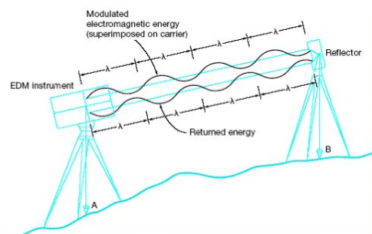
Basic Principle:

Slide 4
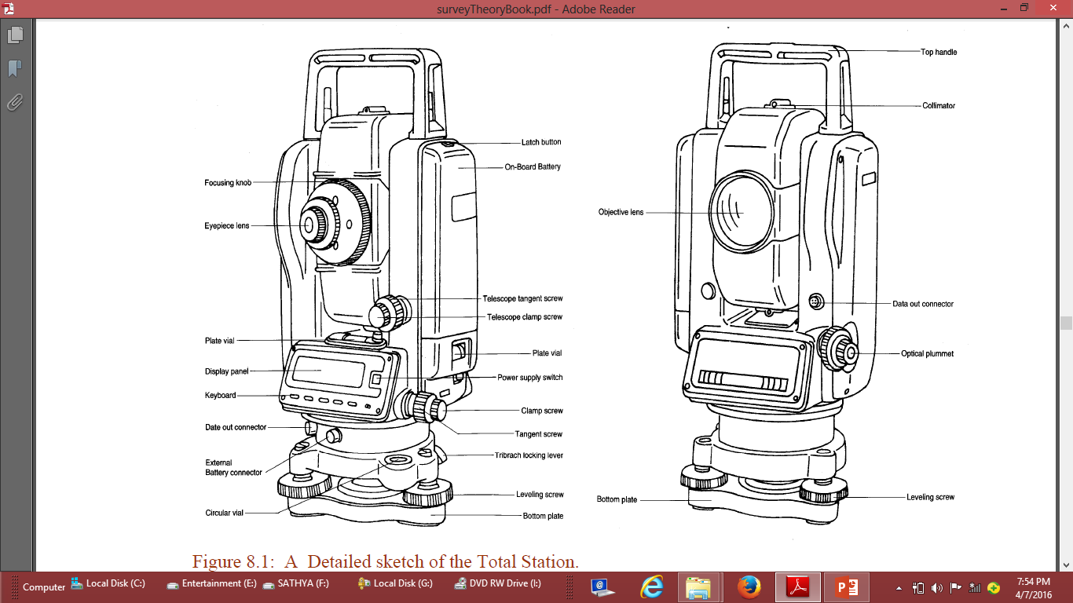

Slide 7
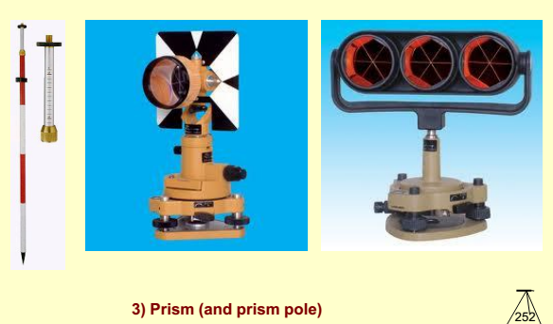
Prism reflector:
It is a combination of ranging rod, staff and optical cuboidal mirror.
having 2/3 lifts with 5cms interval graduations.
adjustable height from 1.5m to 3.75m.
More number of prisms, will give more accuracy.

Slide 8
Components of Total Station:
Distance measuring Instrument(EDM)
An angle measuring Instrument(Theodolite)
A simple microprocessor.
A typical Total Station has the following Characters.
Graphic Display
Dual axis compensation
Levelling and Centering
Storage
Friction clutch and endless drive
Guide light or Lumiguide tracking light
Measurement modes
Automatic target recognition(ATR)

Slide 9
Functions of T.S:
1. It simultaneously measures angles & distances and Record
2. Correcting the measured distance with:
        1. Prism constant
        2. Atmospheric Pr.
        3. Temperature
        4. Curvature of earth
        5. Refraction correction
3. Computing the point elevation
4. Computing the coordinates of every point
5. Remote elevation measurement
6. Remote distance measurement
7. Area calculations
8. Data Transferring facility from instrument to S/W and S/W to instrument
9. Format of conversion of units

Slide 10
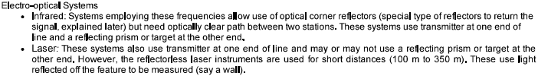
Classification:
Based on
Wavelength used
Working Range
Achievable accuracy
Classification Based on the Wavelength used:
Electro Optical a. Laser (0.4-0.7µm) b. Infrared (0.9µm)
Electronic-Microwave

Slide 11
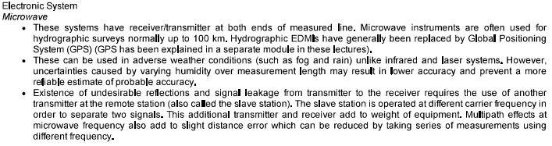

Slide 12

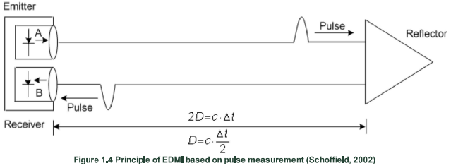
Measuring Principle:
Usually the measuring wave is used along with the carrier wave due to its poor propagation.
Hence the propagation will be done by frequency and amplitude modulation.
The measurement of propagation can be done by following techniques:

Slide 13
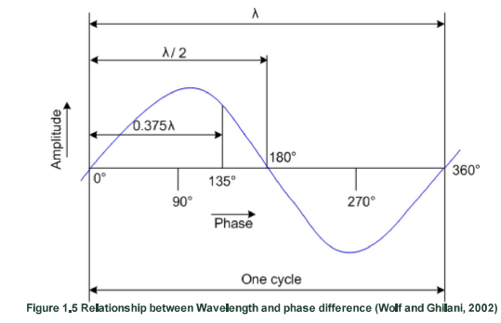
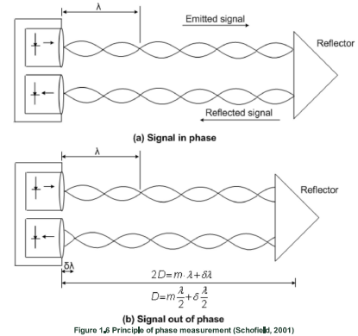
Phase Difference method:

Slide 14
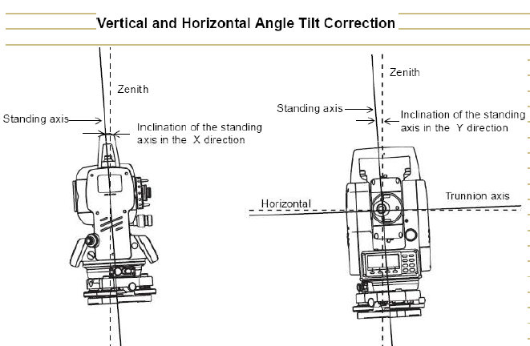

Slide 15
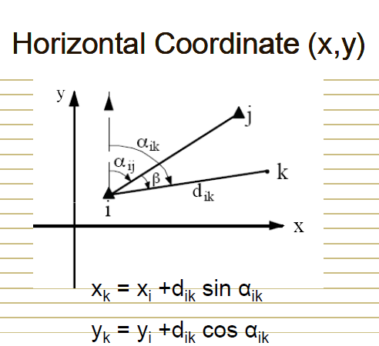

Slide 16
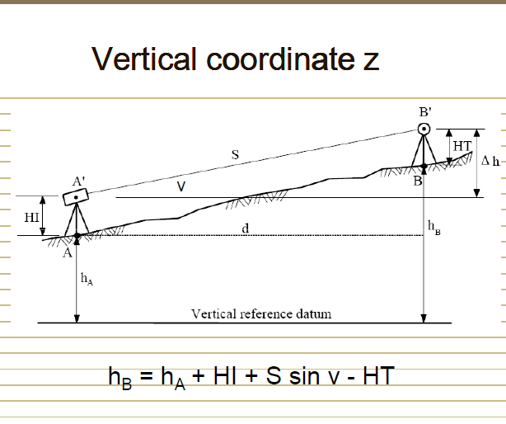

Slide 17
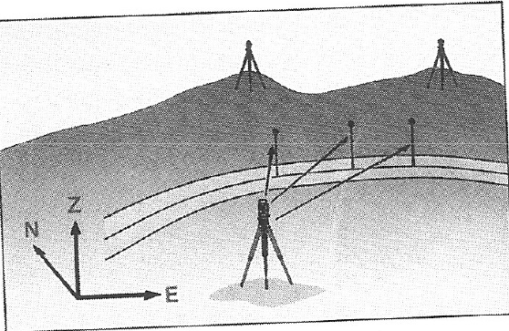

Slide 18
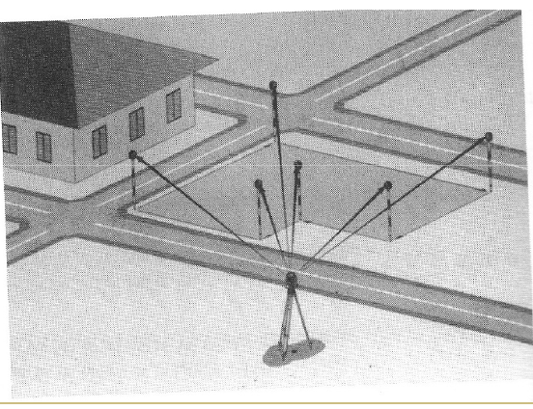

Slide 19
Application of Total station:
      Updating mapping
      Topographic survey
      Hydrographic survey
      Cadastral survey
      Project construction survey
      Road, Rail Survey
      Mining survey

Slide 20
Operations involved while using Total Stations :
Establishing the site Datum:
a) Selecting the site Datum
b) Establishing North
2. Setting up the Total station:
a) Placing and leveling Tripod on Datum
b) Placing and leveling the Gun on Tripod
c) Linking the data connector to Gun
3. Data collector options and setting
a) Main menu
b) Basic setting

Slide 21
4. Creating and Operating Job files:
a) Creating a new Job file
b) Opening an existing file
5. Shooting points
a) Identifying the important points to shoot
b) shooting points
c) Shooting additional points
d) Noting the special features
6.Post Processing – Data down loading,conversion
7.Plotting/Map generation.

Slide 22
