Slide 1
TRIANGULATION

Slide 2
Syllabus
Principle of Trilateration
Reduction of observation
Principle and classification of Triangulation System
Triangulation chains, Strength of Figures, Station marks and Signals, Satellite station, intersected and Resected points
field work- Reconnaissance
Intervisibility of station, Angular measurement
Base line measurement and its extension
Adjustment of Field observation and computation of co-ordinates.

Slide 3
WELL-CONDITIONED TRIANGLES
The triangles of such a shape, in which any error in angular measurement has a minimum effect upon the computed lengths, is known as well-conditioned triangle.
The best shape of an isosceles triangle is that triangle whose base angles are 56°14'each.
From practical considerations, an equilateral triangle may be treated as a well-conditional triangle.
In actual practice, the triangles having an angle less than 30° or more than 120° should not be considered.

Slide 4
STRENGTH OF FIGURE
The strength of figure is a factor considered in establishing a triangulation system to maintain the computations within a desired degree of precision.
It plays an important role in deciding the layout of a triangulation system.
Strength of figure is

Slide 5
STRENGTH OF FIGURE
d = the probable error of an observed direction in seconds of arc
R= a term which represents the shape of a figure
difference per second in the sixth place of logarithm of the sine of the distance angles A, B and C, respectively. (Distance angle is the angle in a triangle opposite to a side)
D = the number of directions observed excluding the known side of the figure = 2 (total number of lines – 1)

Slide 6
STRENGTH OF FIGURE
n′ = the total number of sides including the known side of the figure,
n = the total number of sides observed in both directions including the known side,
S′ = the number of stations occupied, and
S = the total number of stations.

Slide 7
ACCURACY OF TRIANGULATION
The following formula for root mean square error may be used.
Where,
m = the root mean square error of unadjusted horizontal angles in seconds of arc as obtained from
the triangular errors,
ΣE² = the sum of the squares of all the triangular errors in the triangulation series, and
n=the total number of triangles in the series.

Slide 8
Numerical
Compute the value of R for the desired maximum probable error of 1 in 25000 if the probable error of direction measurement is 1.20″.
L being the probable error that would occur in the sixth place of logarithm of any side, we have

Slide 9
Numerical
L= 17
d= 1.20″

Slide 10
Numerical
The probable error of direction measurement is 1". Compute the maximum value of R if the maximum probable error is
(i) 1 in 20000
(ii) 1 in 50000.

Slide 11
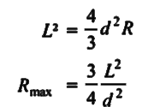
Numerical

Slide 12
Numerical
$$\log{(1±}\frac{1}{50000})=\log\left(1.00002\right)$$
$=8.685 × {10}^{−6}$
L = Sixth place in $8.685 × {10}^{−6}$
= 8.6~~ 9

Slide 13
Numerical
Q. Compute the value of $\frac{D−C}{D}$ for the following triangulation figures if all the stations have been occupied and all the lines have been observed in both directions :
(i) A single triangle
(ii) A braced quadrilateral
(iii) A four-sided central-point figure without diagonals
(iv) A four-sided central-point figure with one diagonal.

Slide 14
Numerical
(i) A single triangle
C= (n' – S' + 1) + (n– 2S + 3)
n'= 3
n= 3
S= 3
S'= 3
C= (3 – 3 + 1) + (3 – 2 × 3 + 3) = 1
D= the number of directions observed excluding the known side. = 2 (total number of lines – 1)
= 2 × (3 – 1) = 4

Slide 15
Numerical
(ii) A braced quadrilateral
C= (n' – S' + 1) + (n– 2S + 3)
n= 6
n'= 6
S= 4
S'= 4
C'= (6 – 4 + 1) + (6 – 2 × 4 + 3) = 4
D= 2 × (6 – 1) = 10

Slide 16
Numerical
(iii) A four-sided central-point figure without diagonals
n= 8
n'= 8
S= 5
S'= 5
C= (8 – 5 + 1) + (8 – 2 × 5 + 3) = 5
D= 2 × (8 – 1) = 14

Slide 17
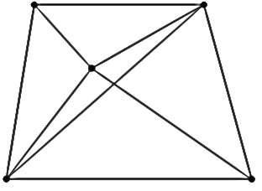
Numerical
(iv) A four-sided central-point figure with one diagonal.
n= 9
n'= 9
S= 5
S'= 5
C= (9 – 5 + 1) + (9 – 2 × 5 + 3) = 7
D= 2 × (9 – 1) = 16

Slide 18
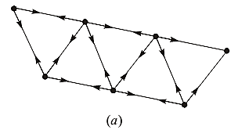
Numerical
Compute the value of $\frac{D−C}{D}$ for the triangulation nets shown . The directions observed are shown by arrows.

Slide 19
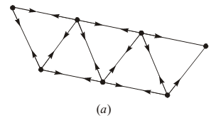
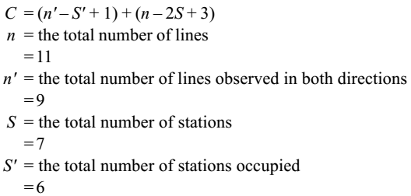

Slide 21
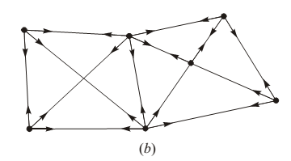

Slide 22
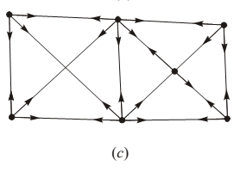
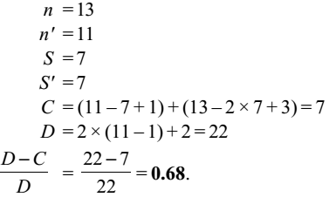

Slide 23
Routine of Triangulation
The routine of triangulation survey, broadly consists of
field work, and
(b) computations.

Slide 24
The field work of triangulation is divided into the following operations :
Reconnaissance
(ii) Erection of signals and towers
(iii) Measurement of base line
(iv) Measurement of horizontal angles
(v) Measurement of vertical angles
(vi) Astronomical observations to determine the azimuth of the lines.

Slide 25
1.1 Reconnaissance
Reconnaissance is the preliminary field inspection of the entire area to be covered by triangulation, and collection of relevant data.
The accuracy and economy of triangulation greatly depends upon proper reconnaissance survey.

Slide 26
1.1 Reconnaissance
It includes the following operations:
1. Examination of terrain to be surveyed.
2. Selection of suitable sites for measurement of base lines.
3. Selection of suitable positions for triangulation stations.
4. Determination of intervisibility of triangulation stations etc.

Slide 27
1.1 Reconnaissance
The main reconnaissance is a very rough triangulation.
For reconnaissance the following instruments are generally employed:
1. Small theodolite and sextant for measurement of angles.
2. Prismatic compass for measurement of bearings.
3. Steel tape.
4. Binocular etc.

Slide 28
1.2 Erection of signals and towers
A Signal is a device erected to define the exact position of a triangulation station so that it can be observed from other stations.
A Tower is a structure over a station to support the instrument and the observer, and is provided when the station or the signal, or both are to be elevated.
Before deciding the type of signal to be used, the triangulation stations are selected.

Slide 29
1.2.1 Criteria for selection of triangulation stations
Triangulation stations should be intervisible. For this purpose the station points should be on the highest ground such as hill tops, house tops, etc.
Stations should be easily accessible with instruments.
Station should form well-conditioned triangles.
Stations should be so located that the lengths of sights are neither too small nor too long. Small sights cause errors of bisection and centering. Long sights too cause direction error as the signals become too indistinct for accurate bisection.

Slide 30
1.2.1 Criteria for selection of triangulation stations
Stations should be at commanding positions so as to serve as control for subsidiary triangulation, and for possible extension of the main triangulation.
Grazing line of sights should be avoided, and no line of sight should pass over the industrial areas to avoid irregular atmospheric refraction.

Slide 31
1.2.2 Determination of intervisibility of triangulation stations
Case-I Invervisibility not obstructed by intervening ground
If the intervening ground does not obstruct the intervisibility, the distance of visible horizon from the station of known elevation is calculated from the following formula:

Slide 32
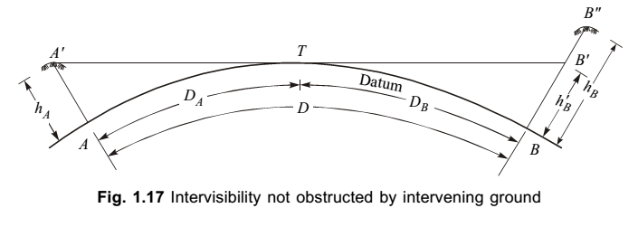
Case-I Invervisibility not obstructed by intervening ground

Slide 33
For the known distance of visible horizon Db, the height of station B is computed.
If the computed value is hb’ , then
B’’
T
A’
B’
hb’
Da
Db
ha
hb
D
A
B

Slide 34
If B is not visible from A, then
(hb - hb‘) − is the required amount of height of signal to be erected at B.
B’’
T
A’
B’
hb’
Da
Db
ha
hb
D
A
B

Slide 35
The line of sight should be taken at least 3 m above the point of tangency T of the earth’s surface to avoid grazing rays.
B’’
T
A’
B’
hb’
Da
Db
ha
hb
D
A
B

Slide 36
Two stations A and B, 80 km apart, have elevations 15 m and 270 m above mean sea level, respectively. Calculate the minimum height of the signal at B.

Slide 37
the elevation of B is 270 m, the height of signal required at B, is = 285.25 – 270 = 15.25 m.

Slide 38
Case-II Intervisibility obstructed by intervening ground
(1st method)

Slide 40
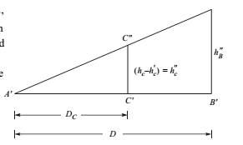

Slide 41
There are two stations P and Q at elevations of 200 m and 995 m, respectively. The distance of Q from P is 105 km. If the elevation of a peak M at a distance of 38km from P is 301 m, determine whether Q is visible from P or not. If not, what would be the height of scaffolding required at Q so that Q becomes visible from P ?

Slide 46
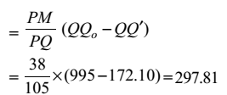

Slide 47
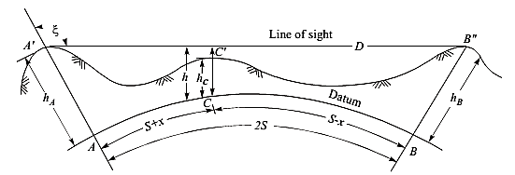
Case-II Intervisibility obstructed by intervening ground
(2nd method – Captain McCaws Method)

Slide 48
In most of the cases, the zenith distance is very nearly equal to 90° and, therefore, the value of cosec² ξ may be taken approximately equal to unity.

Slide 51
The elevation of the line of sight p'Qo at M is 316.24 m, and the elevation of the peak is 301 m, therefore, the line of sight is clear of obstruction.

Slide 52
In a triangulation survey, the altitudes of two proposed stations A and B, 100 km apart, are respectively 425 m and 705 m.
The intervening ground situated at C, 60 km from A, has an elevation of 435 m.
Ascertain if A and B are intervisible, and if necessary find by how much B should be raised so that the line of sight must nowhere be less than 3 m above the surface of the ground. Take R= 6400 km and m= 0.07.

Slide 53
705 m

Slide 54
As the elevation of the line of sight at C is less than the elevation of C, the line of sight fails to clear C by
To avoid grazing rays, the line of should be at least 3m above the ground.
Therefore, the line of sight should be raised to
3.25 + 3 = 6.25 m at C.
Hence, the minimum height of signal to be erected at B
From Similar Triangles :

Slide 55
1.2.3 Station Mark
The triangulation stations should be permanently marked on the stable foundation or rock so that the theodolite and signal may be centered accurately over them.
Generally, a hole 10 to 15 cm deep is made in the rock and a copper or iron bolt is fixed with cement.
The mark may be set on a concrete monument. The station should be marked with a copper or bronze tablet.
The name of the station and the date on which it was set, should be stamped on the tablet.

Slide 56
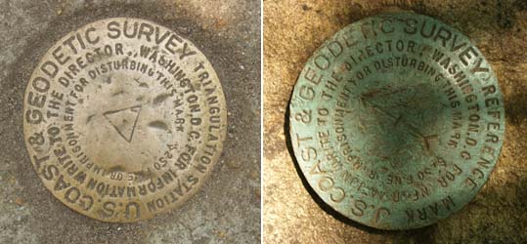
1.2.3 Station Mark
Three reference marks at some distances on fairly permanent features, should be established to locate the station mark, if it is disturbed or removed.
Triangulation station
Reference station

Slide 57
1.2.4 Signals
Signals are centered vertically over the station mark, and the observations are made to these signals from other stations.
The accuracy of triangulation is entirely dependent on the degree of accuracy of centering the signals.
Therefore, it is very essential that the signals are truly vertical, and centered over the station mark.

Slide 58
1.2.4 Signals
A signal should fulfil the following requirements :
It should be clearly visible against any background. To make the signal conspicuous, it should be kept at least 75 cm above the station mark.
It should be capable of being accurately centered over the station mark.
It should be free from phase, or should exhibit little phase.

Slide 59
1.2.5 Classification of signals
The signals may be classified as under :
(i) Non-luminous, opaque or daylight signals
(ii) Luminous signals.
(i) Non-luminous signals
Non-luminous signals are used during day time and for short distances.
These are of various types, and the most commonly used are of following types:

Slide 60
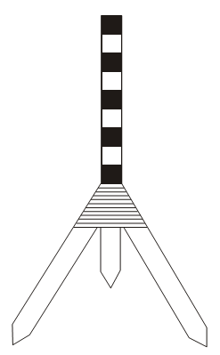
1.2.5 Classification of signals
Pole signal :
It consists of a round pole painted black and white in alternate strips, and is supported vertically over the station mark, generally on a tripod.
Pole signals are suitable upto a distance of about 6 km.

Slide 61
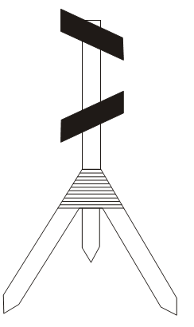
1.2.5 Classification of signals
(b) Target signal :
It consists of a pole carrying two squares or rectangular targets placed at right angles to each other.
Target signals are suitable upto a distance of 30 km.

Slide 62
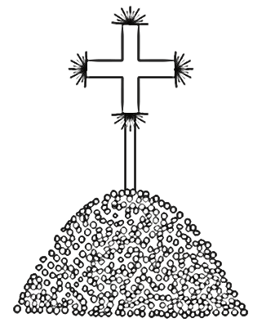
1.2.5 Classification of signals
(c) Pole and brush signal
It consists of a straight pole about 2.5 m long with a bunch of long grass tied symmetrically round the top making a cross

Slide 63
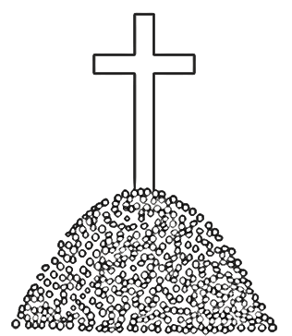
1.2.5 Classification of signals
(d) Stone cairn
A pile of stone heaped in a conical shape about 3 m high with a cross shape signal erected over the stone heap, is stone cairn.
This white washed opaque signal is very useful if the background is dark.

Slide 64
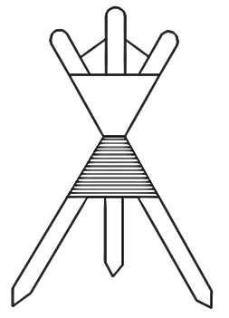
1.2.5 Classification of signals
(e) Beacons
It consists of red and white cloth tied round the three straight poles.
The beacon can easily be centered over the station mark.
It is very useful for making simultaneous observations.

Slide 65
1.2.5 Classification of signals
(ii) Luminous signals
Luminous signals may be classified into two types :
(i) Sun signals
(ii) Night signals.
(a) Sun signals : Sun signals reflect the rays of the sun
towards the station of observation, and are also known as heliotropes. Such signals can be used only in day time in clear weather.

Slide 66
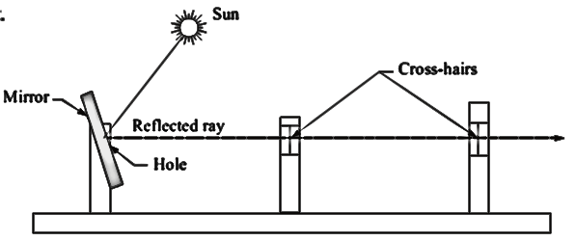
Heliotropes

Slide 67
1.2.5 Classification of signals
b) Night signals:
When the observations are required to be made at night, the night signals of following types may be used.
1. Various forms of oil lamps with parabolic reflectors for sights less than 80 km.
2. Acetylene lamp designed by Capt. McCaw for sights more than 80 km.
3. Magnesium lamp with parabolic reflectors for long sights.

Slide 68
1.2.6 TOWERS
A tower is erected at the triangulation station when the station or the signal or both are to be elevated to make the observations possible form other stations in case of problem of intervisibility.
The height of tower depends upon the character of the terrain and the length of the sight.

Slide 69
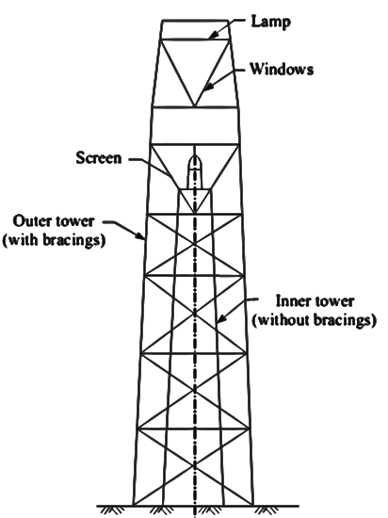
1.2.6 TOWERS
The towers generally have two independent structures.
The outer structure is for supporting the observer and the signal whereas the inner one is for supporting the instrument only.

Slide 70
1.2.7 Phase of Signal
When cylindrical opaque signals are used, they require a correction in the observed horizontal angles due an error known as the phase.
The cylindrical signal is partly illuminated by the sun, and the other part remains in shadow, and becomes invisible to the observer.
Visible
portion
Shadowed
Portion

Slide 71
1.2.7 Phase of Signal
While making the observations, the observer may bisect the bright portion or the bright line.
Thus the signal is not bisected at the centre, and an error due to wrong bisection is introduced.
It is, thus, the apparent displacement of the signal.
Visible portion
Bisected

Slide 72
1.2.7 Phase of Signal
The phase correction is thus necessary so that the observed horizontal angles may be reduced to that corresponding to the centre of the signal.
Visible portion
Bisected

Slide 73
1.2.7 (i) Observation made on bright portion
S
θ
θ = the angle between the sun and the line OP
α1 and α2 =
The angles BOP and AOP, respectively
D= the horizontal distance OP
α = half of the angle AOB (ie. AOC & COB)
β = the phase correction (COP)
r
P
A
C
B
F
α
α2
α1
β
D
S
θ
O

Slide 74
1.2.7 (i) Observation made on bright portion
S
θ
r
P
A
C
B
F
α
α2
α1
β
D
S
θ
O

Slide 75
1.2.7 (i) Observation made on bright portion
S
θ
r
P
A
C
B
F
α
As the distance PF is very small compared to OP, OF may be taken as OP.
α2
α1
β
D
S
θ
O

Slide 76
1.2.7 (i) Observation made on bright portion
S
θ
r
P
A
C
B
F
α
α2
α1
β
D
S
θ
O

Slide 77
1.2.7 (ii) Observation made on bright line
S
S
In this case, the bright line at C on the cylindrical signal of radius r, is sighted from O
A
r
P
C
F
B
D
S
θ
O

Slide 78
1.2.7 (ii) Observation made on bright line
S
S
θ
Let CO = the reflected ray of the sun from the bright line at C
β = the phase correction
θ = the angle between the sun and the line OP
A
r
P
$$90°−\frac{1}{2}(θ−β)$$
C
F
B
$$90°−\frac{1}{2}(θ−β)$$
β
D
S
$$(θ−β)$$
θ
O

Slide 79
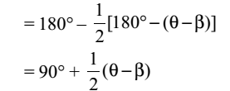
1.2.7 (ii) Observation made on bright line
S
S
θ
A
r
P
$$90°−\frac{1}{2}(θ−β)$$
C
F
B
$$90°−\frac{1}{2}(θ−β)$$
β
D
S
$$(θ−β)$$
θ
O

Slide 80
1.2.7 (ii) Observation made on bright line
S
S
θ
A
r
P
As βis very small compared to θ
it can be ignored
$$90°−\frac{1}{2}(θ−β)$$
C
F
B
$$90°−\frac{1}{2}(θ−β)$$
β
D
S
$$(θ−β)$$
θ
O

Slide 81
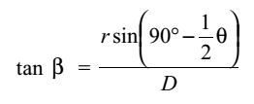
1.2.7 (ii) Observation made on bright line
S
S
θ
A
r
P
$$90°−\frac{1}{2}(θ−β)$$
C
F
B
PF being very small compared to OP, OF may be taken as OP= D
$$90°−\frac{1}{2}(θ−β)$$
β
D
S
$$(θ−β)$$
θ
O

Slide 82
A cylindrical signal of diameter 4 m, was erected at station B. Observations were made on the signal from station A.
Calculate the phase corrections when the observations were made
(i) on the bright portion, and
Take the distance AB as 6950 m, and the bearings of the sun and the station B as 315° and 35°, respectively.

Slide 83
the phase corrections when the observations were made
(i) on the bright portion

Slide 84
the phase corrections when the observations were made
(ii) on the bright line.

Slide 85
The horizontal angle measured between two stations P and Q at station R, was 38°29'30".
The station Q is situated on the right of the line RP.
The diameter the cylindrical signal erected at station P, was 3 m and the distance between P and R was 5180 m.
The bearing of the sun and the station P were measured as 60° and 15°, respectively.
If the observations were made on the bright line, compute the correct horizontal angle PRQ

Slide 86
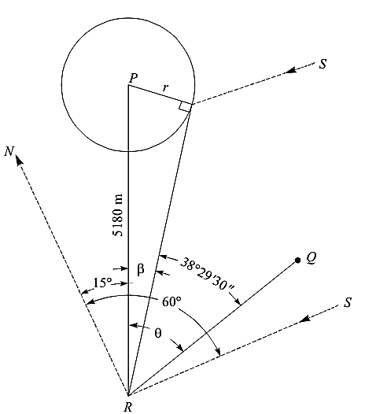

Slide 87
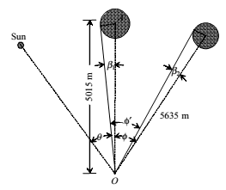
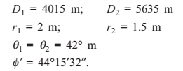
Extra Examples
4015 m

Slide 88
4015 m

Slide 89
4015 m

Slide 90
4015 m

Slide 91
1.3 Measurement of Baseline
As base line forms the basis for computations of triangulation system, it is laid down with great accuracy in its measurement and alignment.
The length of the base line depends upon the grade of the triangulation.
The length of the base is also determined by the desirability of securing strong figures in the base net.

Slide 92
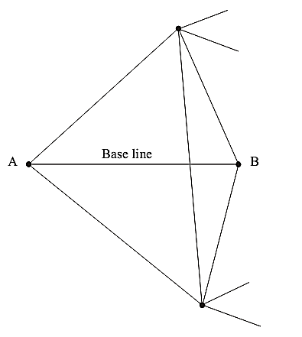
1.3.1 Base Net
Apart from main base line, several other check bases are also measured at some suitable intervals.
The base is connected to the triangulation system through a base net.

Slide 93
1.3.2 Selection of site for base line
The site should be fairly level or gently undulating.
The site should be free from obstructions throughout the length of the base line.
The two extremities of the base line should be intervisible.
The site should be such that a minimum length of the base line as specified, is available.
The site should be such that well-conditioned triangles can be obtained while connecting extremities to the main triangulation stations.

Slide 94
1.3.3 Equipment for base line measurement
Standardised tapes : These are used for measuring short bases in plain grounds (INVAR tapes).
Hunter’s short base: It is used for measuring 80 m long base line and its extension is made by subtense method.
Tacheometric base measurements : It is used in undulating grounds for small bases
Electronic distance measurement: This is used for fairly long distances

Slide 95
1.3.4 Extension of base line
Usually the length of the base lines is much shorter than the average length of the sides of the triangles.
This is mainly due to the following reasons:
(a) It is often not possible to get a suitable site for a longer base.
(b) Measurement of a long base line is difficult and expensive.
The extension of short base is done through forming a base net consisting of well-conditioned triangles.
Small angles opposite the known sides must be avoided.

Slide 96
1.3.4 Extension of base line
There are two ways of connecting the selected base to the triangulation stations.
(a) extension by prolongation, and
(b) extension by double sighting.

Slide 97
1.3.4 (a) Extension by prolongation
Let us suppose that AB is a short base line which is required to be extended by four times. The following steps are involved to extend AB.
F
C
A
B
E
D
G

Slide 98
1.3.4 (a) Extension by prolongation

Slide 99
1.3.4 (b) Extension by double sighting
C
E
A
B
F
D

Slide 100
1.3.5 Corrections to be applied in base line Measurement
1. The Temperature correction (+ve / -ve) given by
2. The Sag correction (negative) given by
3. The Slope correction (negative) given by
4. Pull correction (+ve / -ve) given by
5. Reduced length at mean sea level is

Slide 101
A base line was measured between two points A and B at an average elevation of 224.35 m.
The corrected length after applying all correction was 149.3205 m.
Reduce the length to mean sea level. Take earth’s mean radius as 6367 km.
L= 149.3205 m
B
A
Average h = 224.35m
L’
R+h
Mean Sea Level
R

Slide 102
$$\frac{L′}{R}=\frac{L}{R+h}$$
$$\frac{L′}{6367}=\frac{149.3205}{6367+ \frac{224.35}{1000}}$$
$L′=\frac{6367×149.3205}{6367+ \frac{224.35}{1000}}$ =149.3152 m
L= 149.3205 m
B
A
Average h = 224.35m
L’
R+h
Mean Sea Level
R

Slide 105
A tape of standard length 20 m at 85° F was used to measure a base line. The measured distance was 82.10 m. The following being the slopes for the various segments of the line.
Find the true length of the base line if the mean temperature during measurement was 63°F. The coefficient of expansion of the tape material is 6.5 × 10^{–6} per °F.

Slide 107
1.3.4 (b) Extension by double sighting
Let AB be the base line. To extend the base to the length of side EF, following steps are involved.
(i) Chose intervisible points C, D, E, and F.
(ii) Measure all the angles marked in triangles ABC and ABD. The most probable values of these angles are found by the theory of least-squares .
(iii) Calculate the length of CD from these angles and the measured length AB, by applying the sine law to triangles ACB and ADB first, and then to triangles ADC and BDC.
(iv) The new base line CD can be further extended to the length EF following the same procedure as above. The line EF may from a side of the triangulation system.

Slide 108
1.4 MEASUREMENT OF HORIZONTAL ANGLES
The instruments used for triangulation surveys, require great degree of precision.
Horizontal angles are generally measured with an optical or electronic theodolite in primary and secondary triangulation.
The horizontal angles of a triangulation system can be observed by repetition method.

Slide 109
1.4 Repetition method
1st method of Repetition method
In the first method, the angle is measured clockwise by 6 repetitions keeping the telescope normal.
The first value of the angle is obtained by dividing the final reading by 6.
The telescope is inverted, and the angle is measured again in anticlockwise direction by 6 repetitions.
The second value of the angle is obtained by dividing the final reading by 6.

Slide 110
1.4 Repetition method
The mean of the first and second values of the angle is the average value of the angle by first set.
For first-order work, five or six sets are usually required. The final value of the angle is the mean of the values obtained by different sets.
For first-order work, five or six sets are usually required.
The final value of the angle is the mean ofthe values obtained by different sets.

Slide 111
1.4 Repetition method (1st method)
6 times
Anti Clockwise reading
6 times
Clockwise reading
Top
Bottom
Normal
Inverted
Bottom
Top

Slide 112
1.4 Repetition method
2nd method of Repetition method
In the second method, the angle is measured clockwise by six repetitions, the first three with telescope normal and the last three with telescope inverted.
The first value of the angle is obtained by dividing the final reading by 6.
Now without altering the reading obtained in the sixth repetition, the angle (i.e., 360°– the angle), is measured clockwise by six repetitions, the first three with telescope inverted and the last three with telescope normal.

Slide 113
1.4 Repetition method
The final reading should theoretically be zero.
If the final reading is not zero, the error is noted, and half of the error is distributed to the first value of the angle.
The result is the corrected value of the angle by the first set.
As many sets as desired are taken, and the mean of all the value of various sets, is the average value of the angle.

Slide 114
1.4 Repetition method (2nd method)
3 times
Clockwise reading
3 times
Clockwise reading
Top
Bottom
Normal
Inverted
Bottom
Top
Total 6 readings

Slide 115
1.4 Repetition method (2nd method)
3 times
Clockwise reading
3 times
Clockwise reading
Bottom
Top
Normal
Inverted
Top
Bottom
Total 6 readings

Slide 116
1.5 MEASUREMENT OF VERTICAL ANGLES
Measurement of vertical angles is required to compute the elevation of the triangulation stations.

Slide 117
1.6 ASTRONOMICAL OBSERVATIONS
To determine the azimuth of the initial side, intermediate sides, and the last side of the triangulation net, astronomical observations are made.

Slide 118
2.1 SOME EXTRA PRECAUTIONS IN TAKING OBSERVATIONS
The instrument and signals have been centred very carefully.
Phase in signals has been eliminated.
The instrument is protected form the heating effects of the sun and vibrations caused by wind.
The support for the instrument is adequately stable.
In case of adverse horizontal refraction, observations should be rescheduled to the time when the horizontal refraction is minimum.

Slide 119
3.1 SATELLITE STATION AND REDUCTION TO CENTRE
To secure well-conditioned triangles or to have good visibility, objects such as chimneys, church spires, flat poles, towers, lighthouse, etc., are selected as triangulation stations.
Such stations can be sighted from other stations but it is not possible to occupy the station directly below such excellent targets for making the observations by setting up the instrument over the station point.

Slide 120
3.1 SATELLITE STATION AND REDUCTION TO CENTRE
A, B, and C are the three triangulation stations.
It is not possible to place instrument at C.
To solve this problem another station S, in the vicinity of C, is selected where the instrument can be set up, and from where all the three stations are visible for making the angle observations. Such station is known as satellite station.
As the observations from Care not possible, the observations form S are made on A,B, and , C from A and Bon C. From the observations made, the required angle ACB is calculated. This is known as reduction to centre.

Slide 121
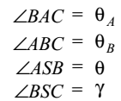
3.1 SATELLITE STATION AND REDUCTION TO CENTRE
A
B
$$θ_{A}$$
$$θ_{B}$$
$$θ$$
$$γ$$
S
C
$$d$$

Slide 122
3.1 SATELLITE STATION AND REDUCTION TO CENTRE
A
c
B
$$θ_{A}$$
$$θ_{B}$$
$$α$$
$$b$$
$$β$$
$$a$$
$$θ$$
$$∅$$
$$γ$$
S
C
$$d$$

Slide 123
3.1 SATELLITE STATION AND REDUCTION TO CENTRE
A
$$c$$
B
$$θ_{A}$$
$$θ_{B}$$
$$α$$
$$c$$
$$β$$
$$a$$
$$θ$$
$$∅$$
$$γ$$
S
C
$$d$$

Slide 124
3.1 SATELLITE STATION AND REDUCTION TO CENTRE
A
$$c$$
B
$$θ_{A}$$
$$θ_{B}$$
$$α$$
$$c$$
$$β$$
$$a$$
$$θ$$
$$∅$$
$$γ$$
S
C
$$d$$

Slide 125
3.1 SATELLITE STATION AND REDUCTION TO CENTRE
As the satellite station S is chosen very close to the main station C
The angles α and β are extremely small.
Therefore, taking Sin α = α , Sin β = β in radians.
in radians.
in radians.
a ,b , d, γ and θ are known quantities, therefore, the values of α, β and can be computed.

Slide 126
3.1 SATELLITE STATION AND REDUCTION TO CENTRE
Above gives the value of φ when the satellite station S is to the left of the main station C.

Slide 127
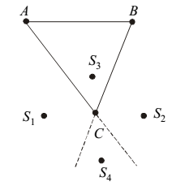
3.1 SATELLITE STATION AND REDUCTION TO CENTRE
Four cases can occur depending on the field conditions

Slide 128
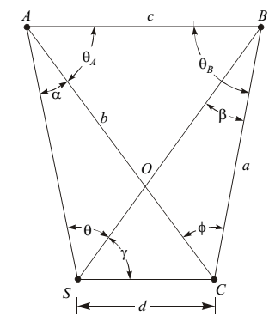
3.1 SATELLITE STATION AND REDUCTION TO CENTRE
1st case : S is in left of C
in radians.

Slide 129
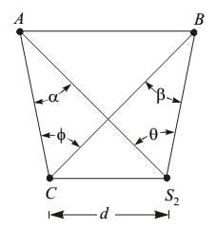
3.1 SATELLITE STATION AND REDUCTION TO CENTRE
2nd case : S is in right of C
c
In Triangle AC S2
$$\frac{\sin{α}}{d}=\frac{\sin{γ}}{b}$$
a
b
$$α=206265×d ×\frac{\sin{γ}}{b}$$
$$γ$$
In Triangle BC S2
$$\frac{\sin{β}}{d}=\frac{\sin{(θ+γ)}}{b}$$
$$β=206265×d ×\frac{\sin{(θ+γ})}{a}$$

Slide 130
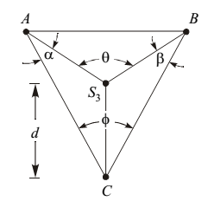
3.1 SATELLITE STATION AND REDUCTION TO CENTRE
3rd case : S inside triangle ABC
c
In Triangle AC S3
$$\frac{\sin{α}}{d}=\frac{\sin{AS_{3}C}}{b}$$
$$α=206265×d×\frac{\sin{AS_{3}C}}{b}$$
b
a
In Triangle BC S3
$$\frac{\sin{β}}{d}=\frac{\sin{BS_{3}C}}{a}$$
$$β=206265×d×\frac{\sin{BS_{3}C}}{a}$$

Slide 131
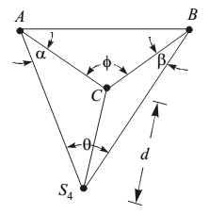
3.1 SATELLITE STATION AND REDUCTION TO CENTRE
4th case : S outside triangle ABC
c
In Triangle AC S4
$$\frac{\sin{α}}{d}=\frac{\sin{AS_{4}C}}{b}$$
b
a
$$α=206265×d×\frac{\sin{AS_{4}C}}{b}$$
In Triangle BC S4
$$\frac{\sin{β}}{d}=\frac{\sin{BS_{4}C}}{a}$$
$$β=206265×d×\frac{\sin{BS_{4}C}}{a}$$

Slide 132
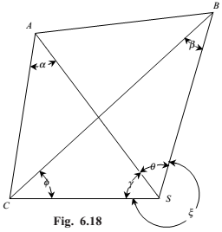
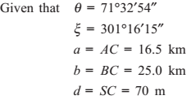

Slide 134
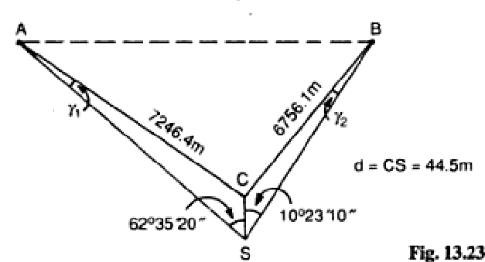

Slide 136
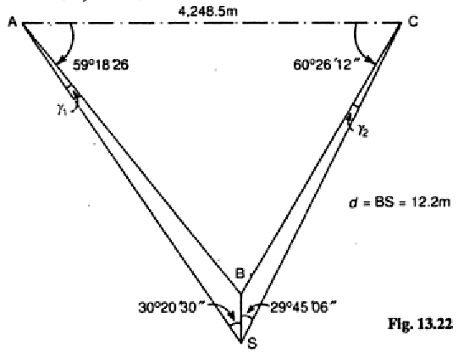

Slide 138
4.1 ECCENTRICITY OF SIGNAL
When the signal is found shifted from its true position, the distance between the shifted signal and the station point ‘d’ is measured.
The corrections α and β to the observed angles BAC and ABC , respectively, are computed

Slide 139
5.1 LOCATION OF POINTS BY INTERSECTION AND RESECTION
The points located by observing directions from the points of known locations, are known as the intersected points
B
$$β$$
C
A
$$γ$$
$$α$$
$$y$$
$$z$$
$$x$$
$$θ$$
$$∅$$
P

Slide 140
5.1 LOCATION OF POINTS BY INTERSECTION
B
$$b$$
$$a$$
$$β$$
C
A
$$γ$$
$$α$$
$$y$$
$$z$$
$$x$$
$$θ$$
$$∅$$
P
Law

Slide 141
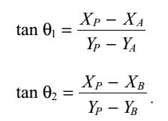
5.2 Computation of Co-ordinates.
If the coordinates of P, A and B are
the reduced bearings
N
P (XP, YP)
N
$$θ_{2}$$
$$θ_{1}$$
A (XA, YA)
B ( XB, YB)

Slide 142
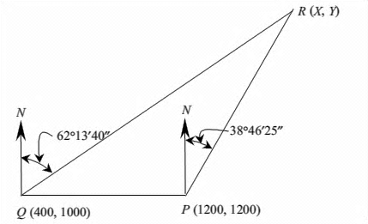

Slide 145
5.3 LOCATION OF POINTS BY RESECTION
When a point is established by taking observations from the point to the points of known locations, such points are known as the resected points
B
$$β$$
C
A
$$γ$$
$$α$$
$$y$$
$$z$$
$$x$$
$$θ$$
$$∅$$
P

Slide 146
5.4 SPHERICAL TRIANGLE
The theodolite measures horizontal angles in the horizontal plane but when the area becomes large, such as in the case of primary triangulation, the curvature of the earthmeans that such planes in large triangles called as spherical triangles or geodetic triangles are not parallel at the apices.
A
Spherical / Geodetic triangle
Plane triangle
B
C

Slide 147
5.4 SPHERICAL TRIANGLE
A
Spherical / Geodetic triangle
Plane triangle
B
C
Accordingly, the three angles of a large triangle do not total 180°, as in the case of plane triangles,
but to 180° + ε, where ε is known as spherical excess.
$$ε= \frac{A_{0}}{R^{2}} ×206265 Seconds$$

Slide 148
5.4 SPHERICAL TRIANGLE
A
Spherical / Geodetic triangle
Plane triangle
B
C

