Slide 1
TRIANGULATION AND TRILATERATION

Slide 2
Syllabus
Principle of Trilateration
Reduction of observation
Principle and classification of Triangulation System
Triangulation chains, Strength of Figures, Station marks and Signals, Satellite station, intersected and Resected points
field work- Reconnaissance
Intervisibillty of station, Angular measurement
Base line measurement and its extension
Adjustment of Field observation and computation of co-ordinates.

Slide 3
Control Surveys
Control surveys establish precise horizontal and vertical positions of reference station.
These serve as the basis for originating or checking subordinate surveys for projects such as topographic and Hydrographic mapping.
There have been two general types of control surveys: horizontal and vertical.
Horizontal surveys generally establish geodetic latitudes and geodetic longitudes of stations over large areas.

Slide 4
Control Surveys
Field procedures used in horizontal control surveys have traditionally been the ground methods of triangulation, precise traversing, trilateration, and combinations of these basic approaches .
Vertical control surveys establish elevations for a network of reference monuments called benchmarks.
Depending on accuracy requirements, they have traditionally been run by either differential levelling or trigonometric levelling.

Slide 5
Triangulation Surveys
Triangulation is one of the methods of fixing accurate controls.
It is based on the trigonometric proposition that if one side and two angles of a triangle are known, the remaining sides can be computed.
Furthermore, if the direction of one side is known, the directions of the remaining sides can be determined.

Slide 6
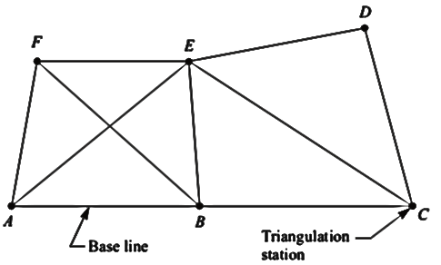
Triangulation Surveys

Slide 7
Triangulation Surveys
A triangulation system consists of a series of joined or overlapping triangles in which an occasional side called as base line, is measured.
Remaining sides are calculated from the angles measured at the vertices of the triangles.
Vertices being the control points are called as triangulation stations.
The side of the triangle whose length is predetermined, is called the base line.

Slide 8
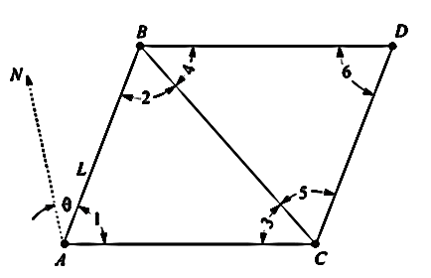
PRINCIPLE OF TRIANGULATION
All the angles in both the triangles and the length L of the side AB, have been measured.

Slide 10
θ

Slide 12
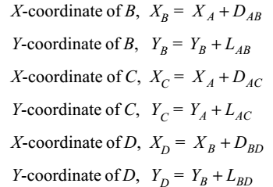

Slide 13
OBJECTIVE OF TRIANGULATION SURVEYS
The main objective of triangulation or trilateration surveys is to provide a number of stations whose relative and absolute positions, horizontal as well as vertical, are accurately established.

Slide 14
Triangulation Surveys
The triangulation surveys are carried out
(i) to establish accurate control for plane and geodetic surveys of large areas, by terrestrial methods,
(ii) to establish accurate control for photogrammetric surveys of large areas,
(iii) to assist in the determination of the size and shape of the earth by making observations for latitude, longitude and gravity.

Slide 15
Triangulation Surveys
(iv) to determine accurate locations of points in engineering works such as :
(a) Fixing centre line and abutments of long bridges over large rivers.
(b) Fixing centre line, terminal points, and shafts for long tunnels.
(c) Transferring the control points across wide sea channels, large water bodies, etc.

Slide 16
Trilateration Surveys
A trilateration system also consists of a series of joined or overlapping triangles.
However, for trilateration the lengths of all the sides of the triangle are measured and few directions or angles are measured to establish azimuth.
Trilateration has become feasible with the development of electronic distance measuring (EDM) equipment which has made possible the measurement of all lengths with high order of accuracy under almost all field conditions.

Slide 18
CLASSIFICATION OF TRIANGULATION SYSTEM
Triangulation surveys are classified as :
First-order or primary.
Second-order or secondary, and
Third-order or tertiary.

Slide 19
First order triangulation system
First-order triangulation is used to determine the shape and size of the earth or to cover a vast area like a whole country with control points to which a second-order triangulation system can be connected.

Slide 20
Second-order triangulation system
A second-order triangulation system consists of a network within a first-order triangulation.
It is used to cover areas of the order of a region, small country, or province.

Slide 21
Third-order triangulation system
A third-order triangulation is a framework fixed within and connected to a second-order triangulation system.
It serves the purpose of furnishing the immediate control for detailed engineering and location surveys.

Slide 22
Triangulation system
Characteristics | First Order Triangulation | Second Order Triangulation | Third Order Triangulation
Length of base lines | 8 to 12 km | 2 to 5 km | 100 to 500 m
Length of sides | 16 to 150 km | 10 to 25 km | 2 to 10 km
Average triangulation error | Less than 1” | 3” | 12”
Actual error of base | 1 in 50,000 | 1 in 25,000 | 1 in 10,000
Probable error of base | 1 in 10,00,000 | 1 in 500,000 | 1 in 250,000
Probable error of computed distances | 1 in 50,000 to 1 in 250,000 | 1 in 20,000 to 1 in 50,000 | 1 in 5,000 to 1 in 20,000

Slide 23
Triangulation Figures & Layouts
The basic figures used in triangulation networks are
1. Single chain of triangles
2. Double chain of triangles
3. Braced quadrilaterals
4. Centered triangles and polygons
5. A combination of above systems.

Slide 24
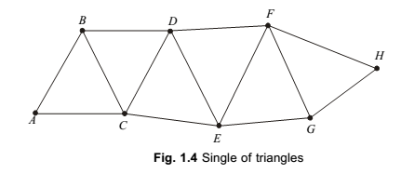
Single Chain of Triangles
When the control points are required to be established in a narrow strip of terrain such as a valley between ridges, a layout consisting of single chain of triangles is generally used

Slide 25
Single Chain of Triangles
Simple triangles of a triangulation system provide only one route through which distances can be computed, and hence, this system does not provide any check on the accuracy of observations.
Check base lines and astronomical observations for azimuths have to be provided at frequent intervals to avoid excessive accumulation of errors in this layout.

Slide 26
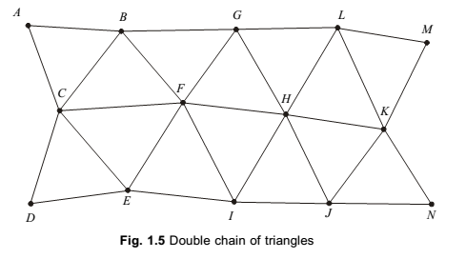
Double Chain of Triangles

Slide 27
Double Chain of Triangles
This arrangement is used for covering the larger width of a belt.
This system also has disadvantages of single chain of triangles system i.e. Check base lines and astronomical observations for azimuths have to be provided at frequent intervals to avoid excessive accumulation of errors in this layout.

Slide 28
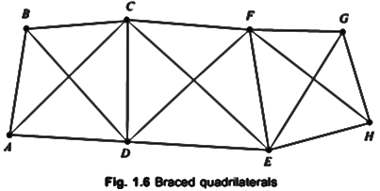
Braced quadrilaterals

Slide 29
Braced quadrilaterals
A triangulation system consisting of figures containing four corner stations and observed diagonals , is known as a layout of braced quadrilaterals.
In fact, braced quadrilateral consists of overlapping triangles.
This system is treated to be the strongest and the best arrangement of triangles, and it provides a means of computing the lengths of the sides using different combinations of sides and angles.

Slide 30
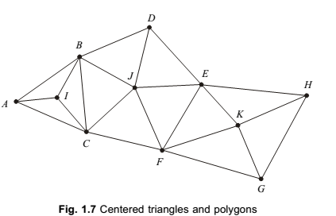
Centered triangles and polygons

Slide 31
Centered triangles and polygons
A triangulation system which consists of figures containing interior stations in triangle and polygon is known as centered triangles and polygons.
This layout in a triangulation system is generally used when vast area in all directions is required to be covered.
Though this system provides checks on the accuracy of the work, generally it is not as strong as the braced quadrilateral arrangement.
Moreover, the progress of work is quite slow due to the fact that more settings of the instrument are required.

Slide 32
A combination of all above systems
Sometimes a combination of above systems may be used which may be according to the shape of the area and the accuracy requirements.

Slide 33
LAYOUT OF PRIMARY TRIANGULATION FOR LARGE COUNTRIES
The following two types of frameworks of primary triangulation are provided for a large country to cover the entire area.
1. Grid iron system
2. Central system.

Slide 34
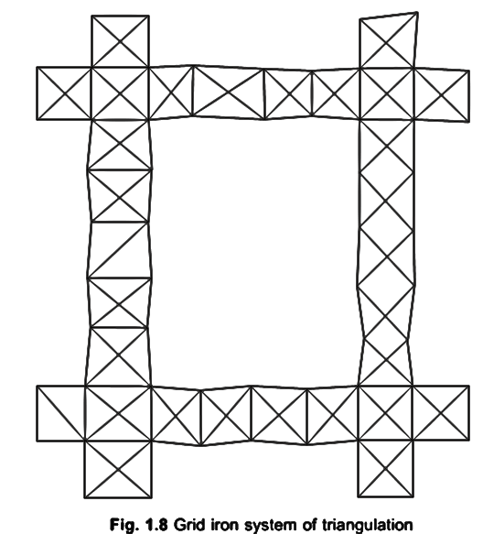
Grid iron system

Slide 35
Grid iron system
In this system, the primary triangulation is laid in series of chains of triangles, which usually runs roughly along meridians (north-south) and along perpendiculars to the meridians (east-west), throughout the country.
The area between the parallel and perpendicular series of primary triangulation, are filled by the secondary and tertiary triangulation systems.
Grid iron system has been adopted in India and other countries like Austria, Spain, France, etc.

Slide 36
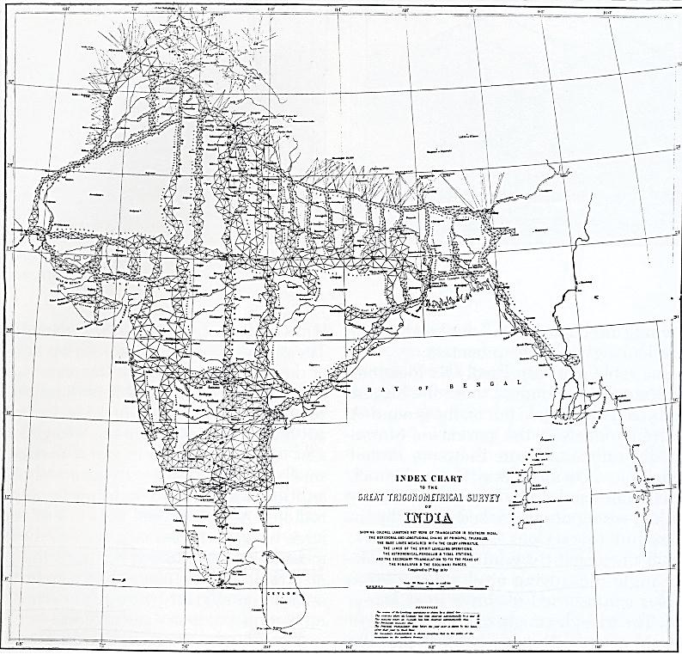
GRID IRON SYSTEM IN INDIA

Slide 37
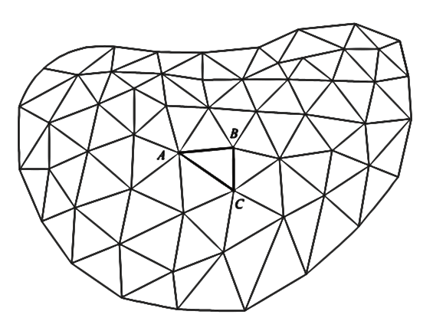
Central system

Slide 38
Central system
In this system, the whole area is covered by a network of primary triangulation extending in all directions from the initial triangulation figure ABC, which is generally laid at the centre of the country
This system is generally used for the survey of an area of moderate extent.
It has been adopted in United Kingdom and various other countries.

Slide 39
CRITERIA FOR SELECTION OF THE LAYOUT OF TRIANGLES
Simple triangles should be preferably equilateral.
2. Braced quadrilaterals should be preferably approximate squares.
3. Centered polygons should be regular.
4. The arrangement should be such that the computations can be done through two or more independent routes.

Slide 40
CRITERIA FOR SELECTION OF THE LAYOUT OF TRIANGLES
5. The arrangement should be such that at least one route and preferably two routes form well conditioned triangles.
6. No angle of the figure, opposite a known side should be small, whichever end of the series is used for computation.
7. Angles of simple triangles should not be less than 45°, and in the case of quadrilaterals, no angle should be less than 30°. In the case of centered polygons, no angle should be less than 40°

Slide 41
CRITERIA FOR SELECTION OF THE LAYOUT OF TRIANGLES
8. The sides of the figures should be of comparable lengths. Very long lines and very short lines should be avoided.
9. The layout should be such that it requires least work to achieve maximum progress.

